Slide 1
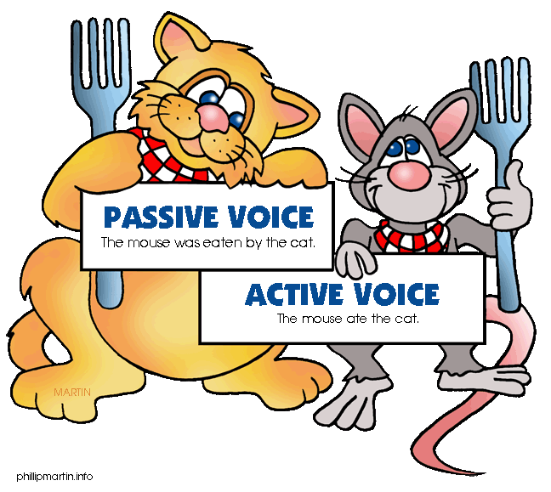
Active and passive voice
Form and use

Slide 2
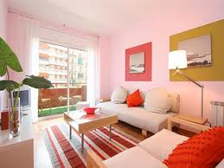
A sad story…
Last week I found a great apartment. The rent was reasonable. That’s why…

Slide 3
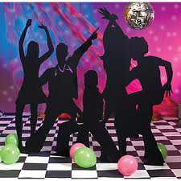
I decided to throw a party the other night.

Slide 4
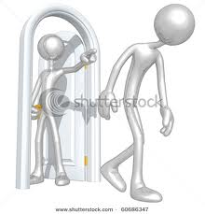
The next day I was thrown out of it!

Slide 5
Active or passive
I threw a party the other night. (active)
meaning: I did something.
I was thrown out of it. (passive)
meaning: Something was done to me.

Slide 6
Form
The passive is formed with the verb to be (in the appropriate tense) + past participle (of the main verb)
    The terrorist was arrested early this morning.
    Toyota cars are made in Japan.
    A new class representative will be chosen on Monday.
    NB These examples show that a passive sentence can be in whatever tense you like. The tense of the verb to be changes to give different tenses in the passive.

Slide 7
Let’s review the verb to be
The Present Simple Tense – AM, IS, ARE
The Present Continuous Tense – AM/IS/ARE BEING
The Present Perfect Tense – HAVE BEEN, HAS BEEN
The Past Simple Tense – WAS, WERE
The Past Continuous Tense – WAS/WERE BEING
The Past Perfect Tense – HAD BEEN
The Future Tense – WILL BE
With modals – CAN BE, WOULD BE, SHOULD BE, MAY BE, MUST BE…

Slide 8
Do these sentences have the same meaning?
What’s the difference?

Slide 9
Use
The passive is more common in written than spoken English. It sounds formal and impersonal, and for that reason is often used in:
  reports of crimes or legal procedures – He was sentenced to two years in prison.
  newspaper reports – The match was postponed due to a heavy fog.
  scientific writing – Three millilitres of water are added to the mixture.
  announcements – Flight BA 302 to London is delayed by two hours.
  notices – Customers are requested not to smoke.

Slide 10
Use
In everyday situations we use it when we do not know or care who performs the action. In other words, the passive is used when we are more interested in what happens to a thing or a person.
Nevertheless, it is not unusual to mention the ‘actual doer’ in a passive sentence. In that case we put them at the end of the sentence after the preposition by:
    “Great expectations” was written by Charles Dickens.
      “Star wars” was directed by George Lucas.

Slide 11

Practice
Put the verbs in brackets into the correct passive form
Shampoo __________ (test) on animals before it ___________ (sell) in shops.
This house __________ (build) in the XIX century.
Two missing children _____________ (find) safe and well.
A new bridge ____________ (construct) next year.

Slide 12
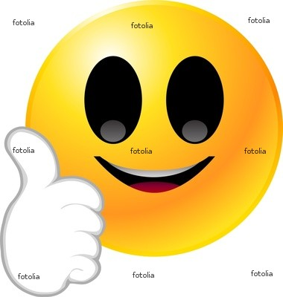
Practice – the key
Put the verbs in brackets into the correct passive form
Shampoo is tested (test) on animals before it is sold (sell) in shops.
This house was built (build) in the XIX century.
Two missing children have been found (find) safe and well.
A new bridge will be constructed (construct) next year.

Slide 13
Active → Passive (steps)
Example:
(active) The postman delivers the letters at 09.00.
Step 1 – identify the object of the active sentence and place it at the beginning of the passive sentence. (the letters)
Step 2 – identify the tense of the active verb and put the verb to be into the same tense. (are)
Step 3 – turn the main active verb into the past participle form. (delivered)
(passive) The letters are delivered at 09.00.

Slide 14
Practice - Active Passive
The police arrested the suspect late last night.
____________________________________
They found him after an intensive search.
____________________________________________________
Two detectives questioned him and charged him with murder.
________________________________________
They will take him to court later today.
_________________________________

Slide 15
Active Passive (the key)
The police arrested the suspect late last night.
The suspect was arrested late last night.
They found him after an intensive search.
He was found after an intensive search.
Two detectives questioned him and charged him with murder.
He was questioned and charged with murder by two detectives.
They will take him to court later today.
He will be taken to court later today.

